Slide 1
Digital Music Metadata
SongKong Music Tagger
Automatically managing your music metadata

Slide 2
Digitized Music Library - Problems
Different mechanisms used to rip or download music
Music stored in different audio formats
Music collections much larger than before
Quality of original metadata varies considerably
No comprehensive metadata standard
Manually adding metadata very time consuming
Impossible to keep metadata consistent as add to collection

Slide 3
SongKong - Concept
Should be possible to automatch and add metadata for majority of music collection easily
Need to apply consistency over collection, and keep consistent
Fix metadata within files so customer not tied to a particular music player (iTunes/Roon, Naim Wav Metadata)
Need rich comprehensive metadata, simple album/artist/title not enough
But need to give customer enough control because there is no such thing as a single one-fit metadata solution
Music collections are valuable and personal so we need
An audit of what has changed
Ability to undo changes if we don’t like them

Slide 4
SongKong Music Tagger Installation
Available for:
Windows
MacOS
Linux
Synology Disk Station
Qnap Nas
Melco N1 Audio Server
Desktop and Remote interface for Windows/MacOS, Linux Desktop
Remote Web Interface for others so can be controlled from web browser even on iPad or phone

Slide 5
Three steps to Improved Metadata
Select your Music folder and Run Fix Songs task.
Review the Options, then press Start
Wait for completion, detailed report shows exactly what has changed

Slide 6
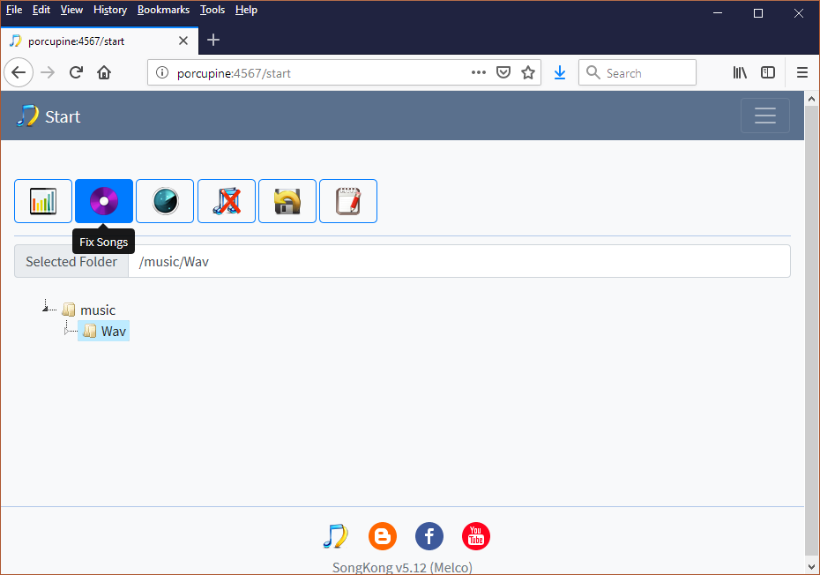
1. Select your Music folder and Run Fix Songs task

Slide 7
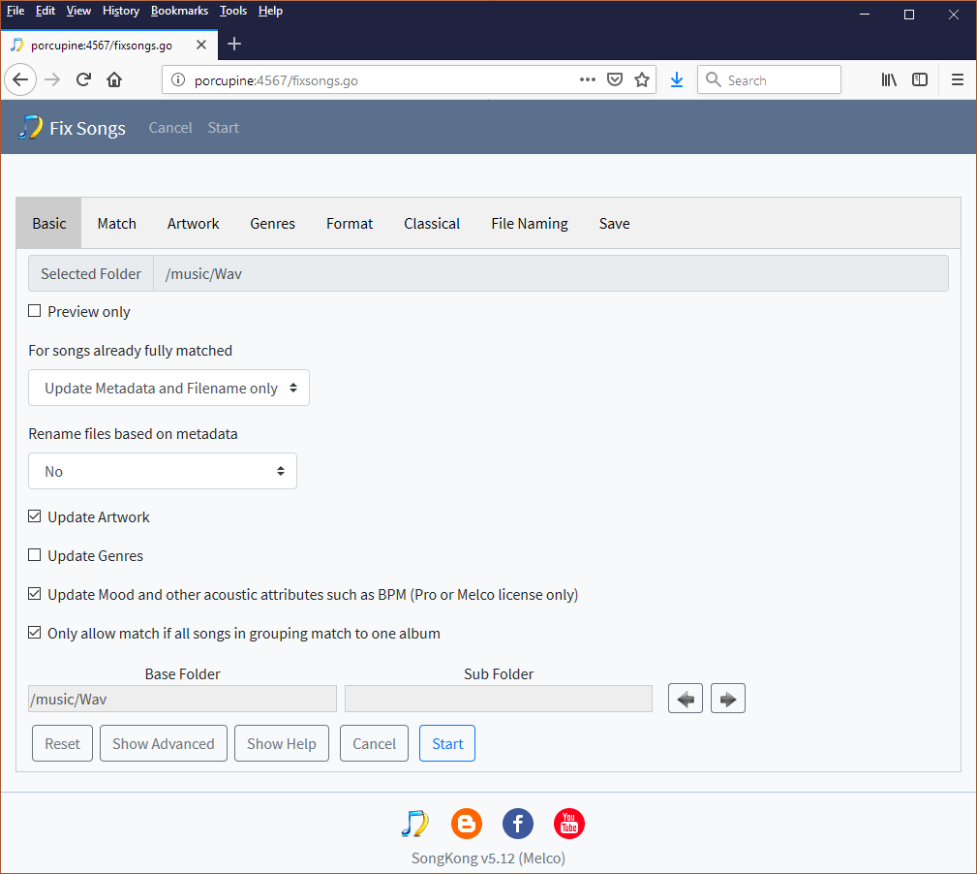
2. Review any Options, e.g Basic Options

Slide 8
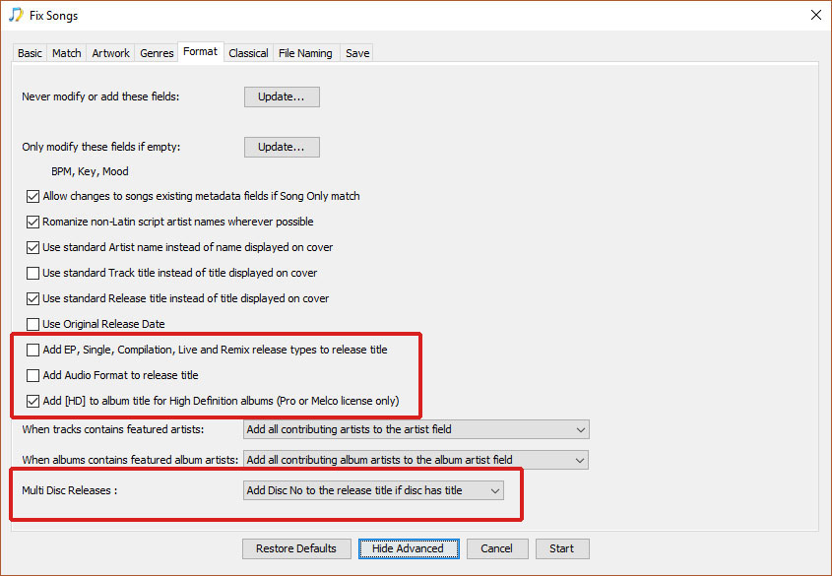
Format Options (Desktop view)

Slide 9
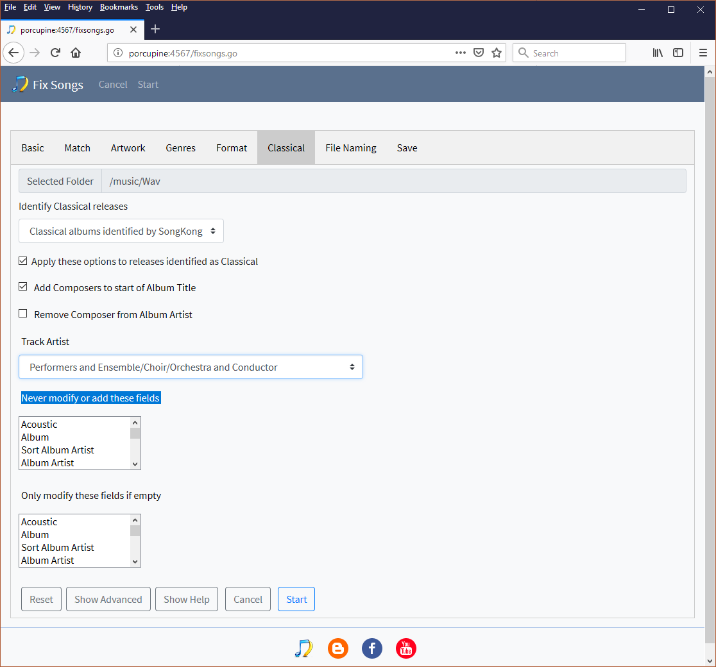
Classical Options (Web Browser View)

Slide 10
.. then press Start

Slide 11
Fix Songs, album and song matching
SongKong utilizes the Albunack database, an enhanced version of MusicBrainz, Discogs AcoustId and Wikipedia combined.
Utilizes audio fingerprinting, existing metadata and folder structure for the bets possible identification
It tries very hard to find a good Album match using a variety of methods. But if it cannot find an acceptable match for all songs to the same album it doesn’t do an album match
But if it can still identify the song it does a Song Only match, and then will only update fields that are not album specific.
i.e. Can Update
i.e. Not update
Track Artist | Title | Composer
Album Artist | Album | Track No

Slide 12
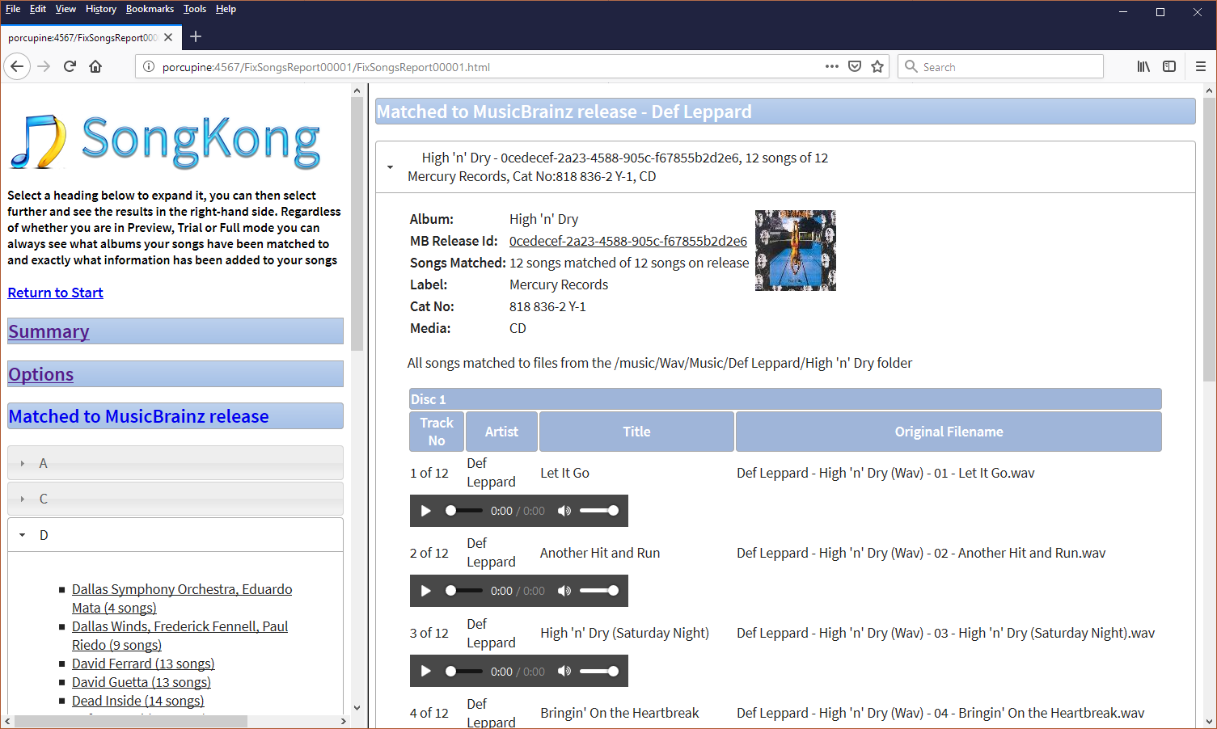
3. Report shows exactly what has changed

Slide 13
Song Changes Report
Gives confidence because:
Html report that opens in browser
Summarises the results with easy to understand bar chart
Records exactly what options were used during the task run
Details exactly what has been matched
And what has changed
Lets you to browse the linked MusicBrainz/Discogs release
Creates a spreadsheet that shows all of your files metadata

Slide 14
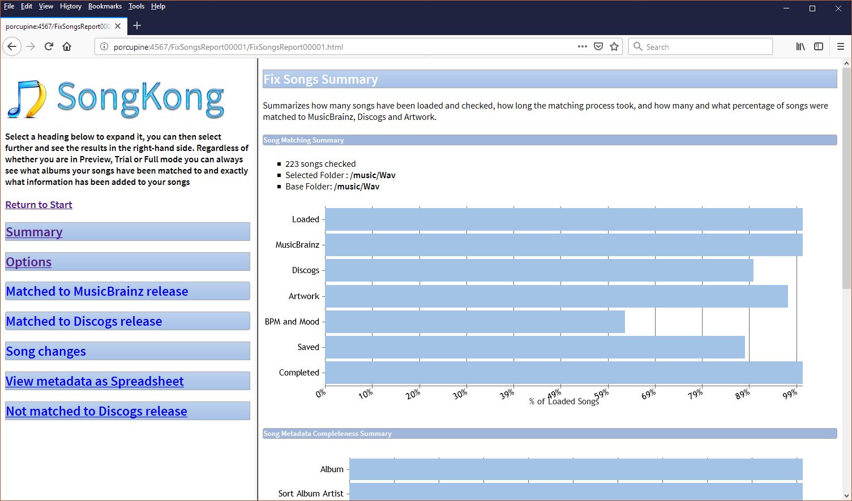
Report - Summary
Bar charts show songs processed, saved and completed
Includes songs matched to MusicBrainz, Discogs and Artwork
Includes start and end date

Slide 15
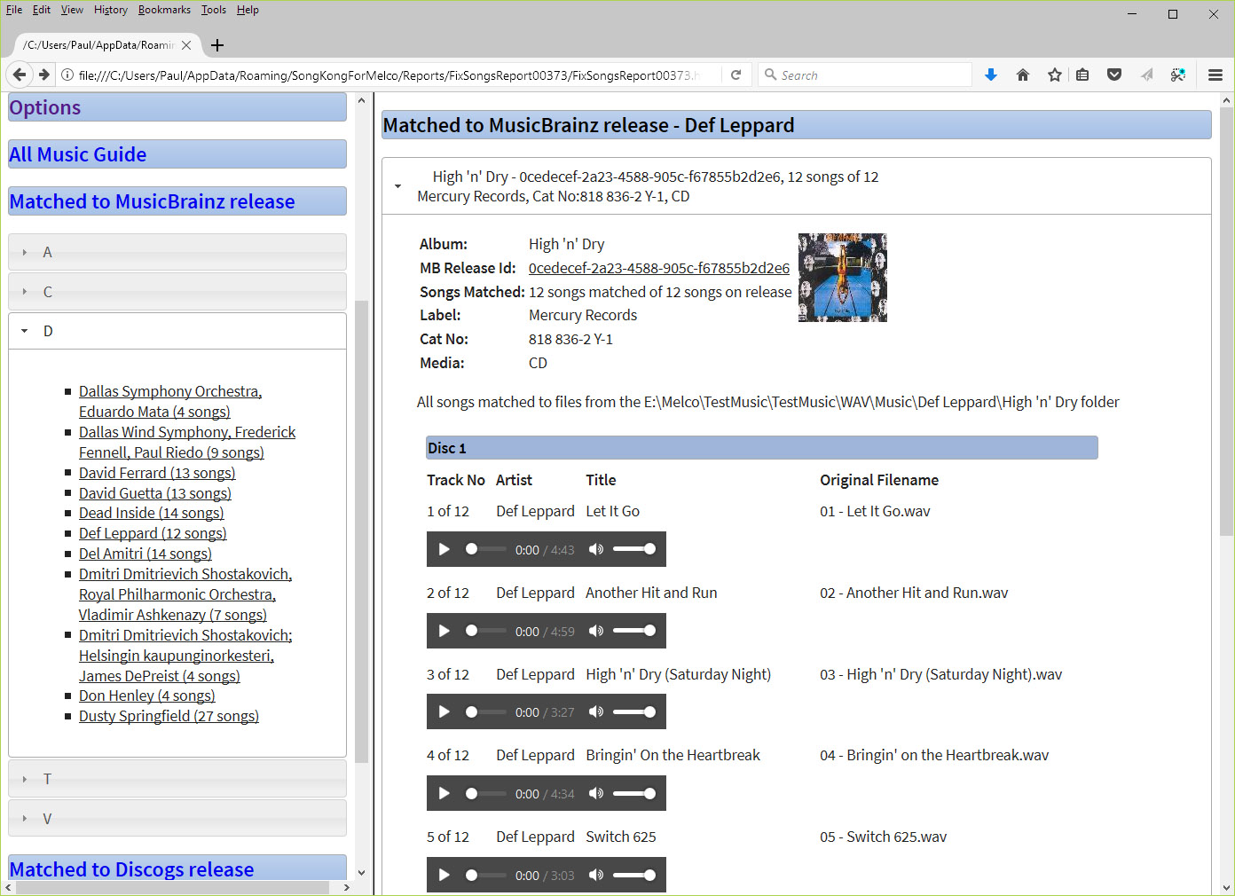
Report - Matched to MusicBrainz/Discogs
Browse how songs have been matched based on the album
You can also play your songs within the browser

Slide 16
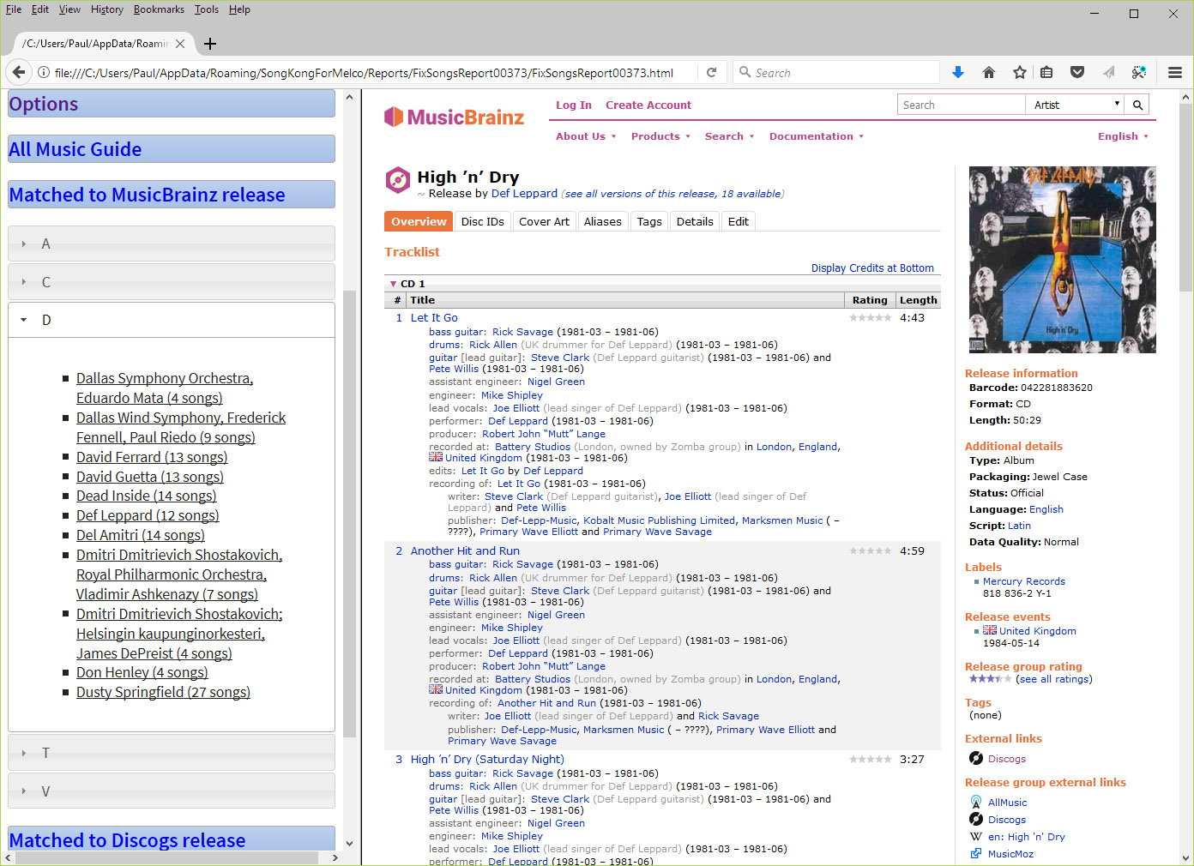
Report - Matched to MusicBrainz – View on MusicBrainz
And you can easily view the release on MusicBrainz itself

Slide 17
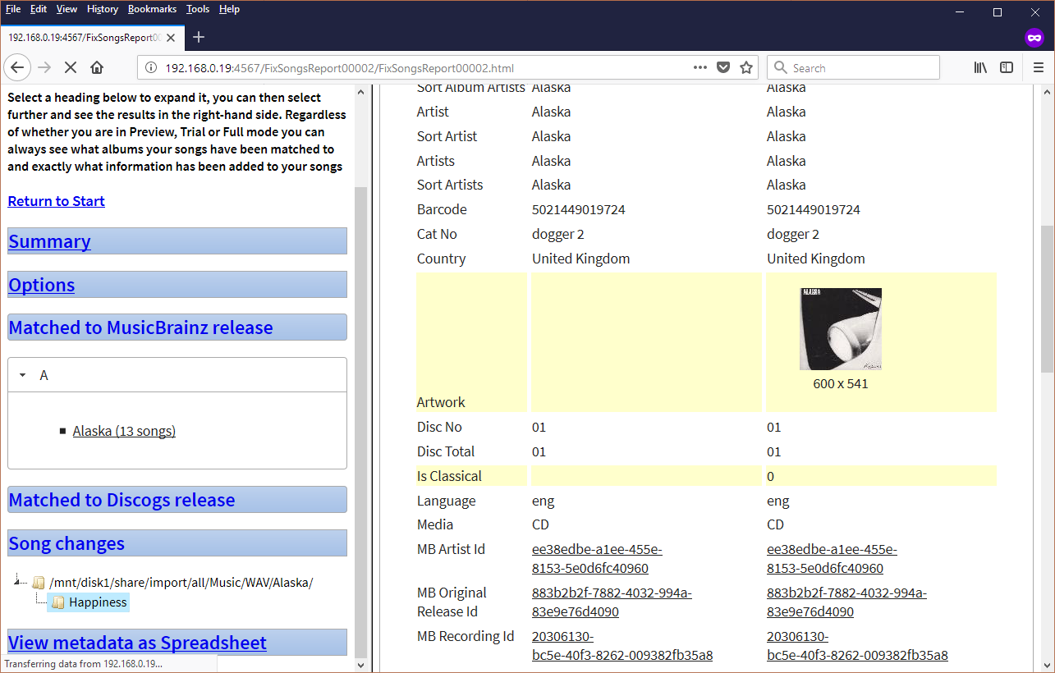
Report - Song Changes
You can drill down to see exactly what fields have been modified or added for a particular file

Slide 18
Undo Changes, in case you change your mind
SongKong adds all the metadata to the file itself so you are not reliant on SongKong after tagging.
But it also writes changes to its internal database.
This means that if you are not happy with the changes at a later date you can revert any changes SongKong has made to any folder.
This can be subfolder of what you ran Fix Songs against
This even applies if SongKong renamed the files
It even applies if you have rebooted

Slide 19
Undo Changes, can track moved files

Slide 20
Other feature of Fix Songs
Add Artwork
Embed WAV metadata from NAIM UnitiServe
Add Genres (from Discogs)
Add BPM (from AcousticBrainz)

Slide 21
High Quality Artwork
Adds high quality artwork from MusicBrainz, Discogs
Can control min/max sizes and resize as required
Can save artwork to filesystem as well as the files themselves to support tools that do not understand embedded metadata
Control if replace existing lower resolution artwork or not

Slide 22
Embed metadata from NAIM UnitiServe
NAIM servers don’t have the ability to add metadata directly to WAV
So they use custom xml files instead
But this means that metadata is lost if move Music files from NAIM
SongKong can read this metadata and put it into the files themselves
This includes user edits made with the Naim app
This is superfast, because only reading local files

Slide 23
Genres and Styles from Discogs, Grey List

Slide 24
BPM and Acoustic Analysis
Crowd-sourced from AcousticBrainz, so we don’t have to analyse files (which is slow) just identify them
BPM
Major KeyInstrumental/Non-instrumental
Acoustic/Electronic

Slide 25
Fix Songs - Review
Gives consistency over your music collection
Highly configurable so can use to suit you
Automated with no user interaction required during matching
Can identify songs without metadata using acoustic fingerprinting
Great depth of metadata added
Supports all major formats including full metadata for WAV and DSF
Report always created showing all modifications
Changes stored in database and can be undone

Slide 26
Delete Duplicates
SongKong can delete duplicates based at song, album and album version level
Can restrict to duplicates within a format so can keep transcoded copies (e.g Wav, flac, mp3)
Delete or move to special deletions folder
Set criteria to decide how the duplicate to keep based on bit depth, audio format, filename ecetera

Slide 27
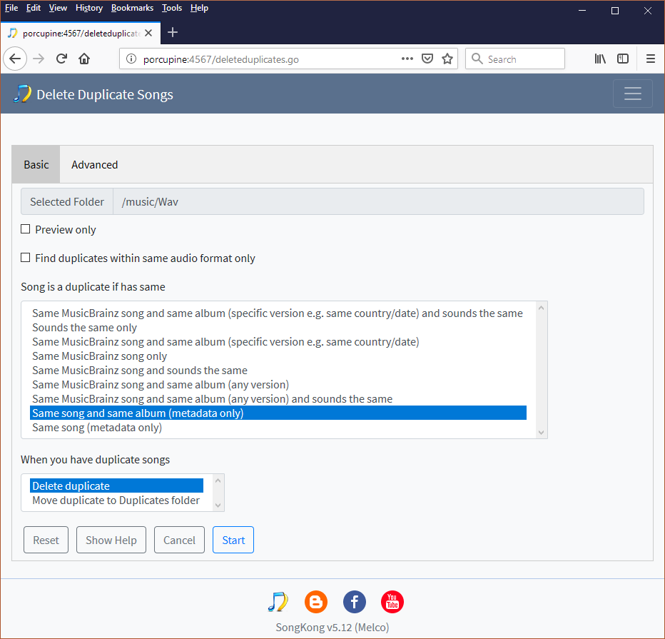
Delete Duplicates – Basic Options

Slide 28
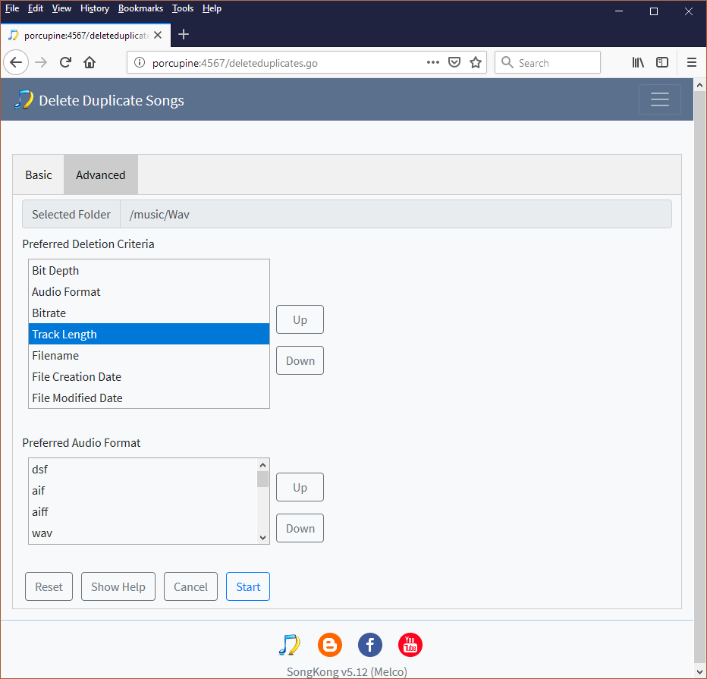
Delete Duplicates – Advanced Options

Slide 29
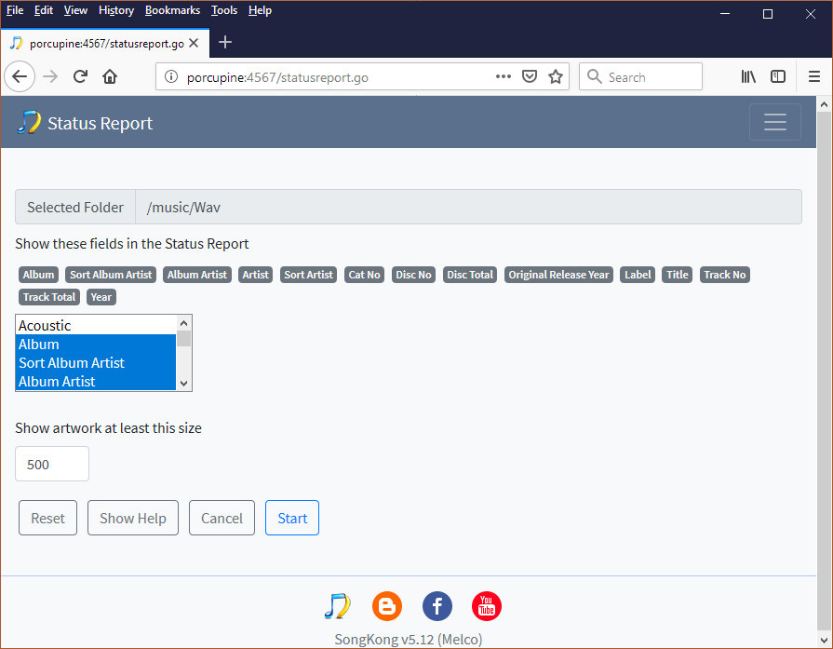
Status Report
Is a very useful tool for taking a snapshot of your music collection

Slide 30
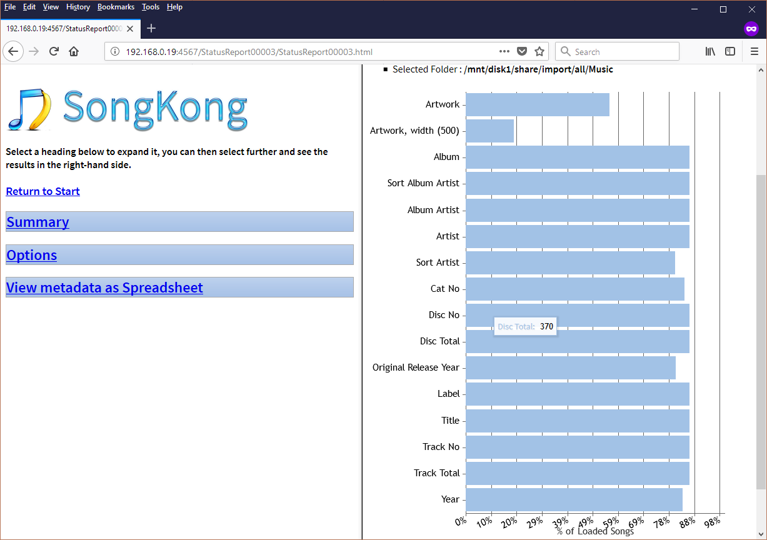
Metadata completeness report of your songs
Can select over 130 different fields to measure

Slide 31
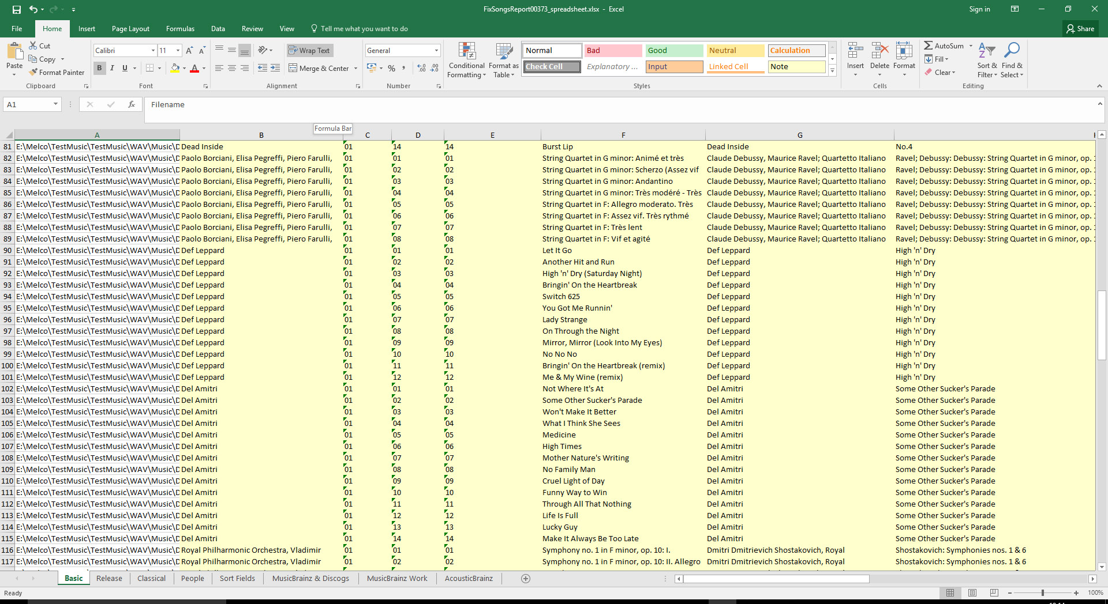
And Create a spreadsheet of all your songs existing metadata.

Slide 32
Manual Edit
SongKong is unlikely to match 100% of your music
And there may be additional data you want to add
So the ability to manually edit is still required
SongKong provides an editor in your web browser (and Desktop)
So you can edit files on headless devices
Powerful spreadsheet based editing
Artwork Search

Slide 33
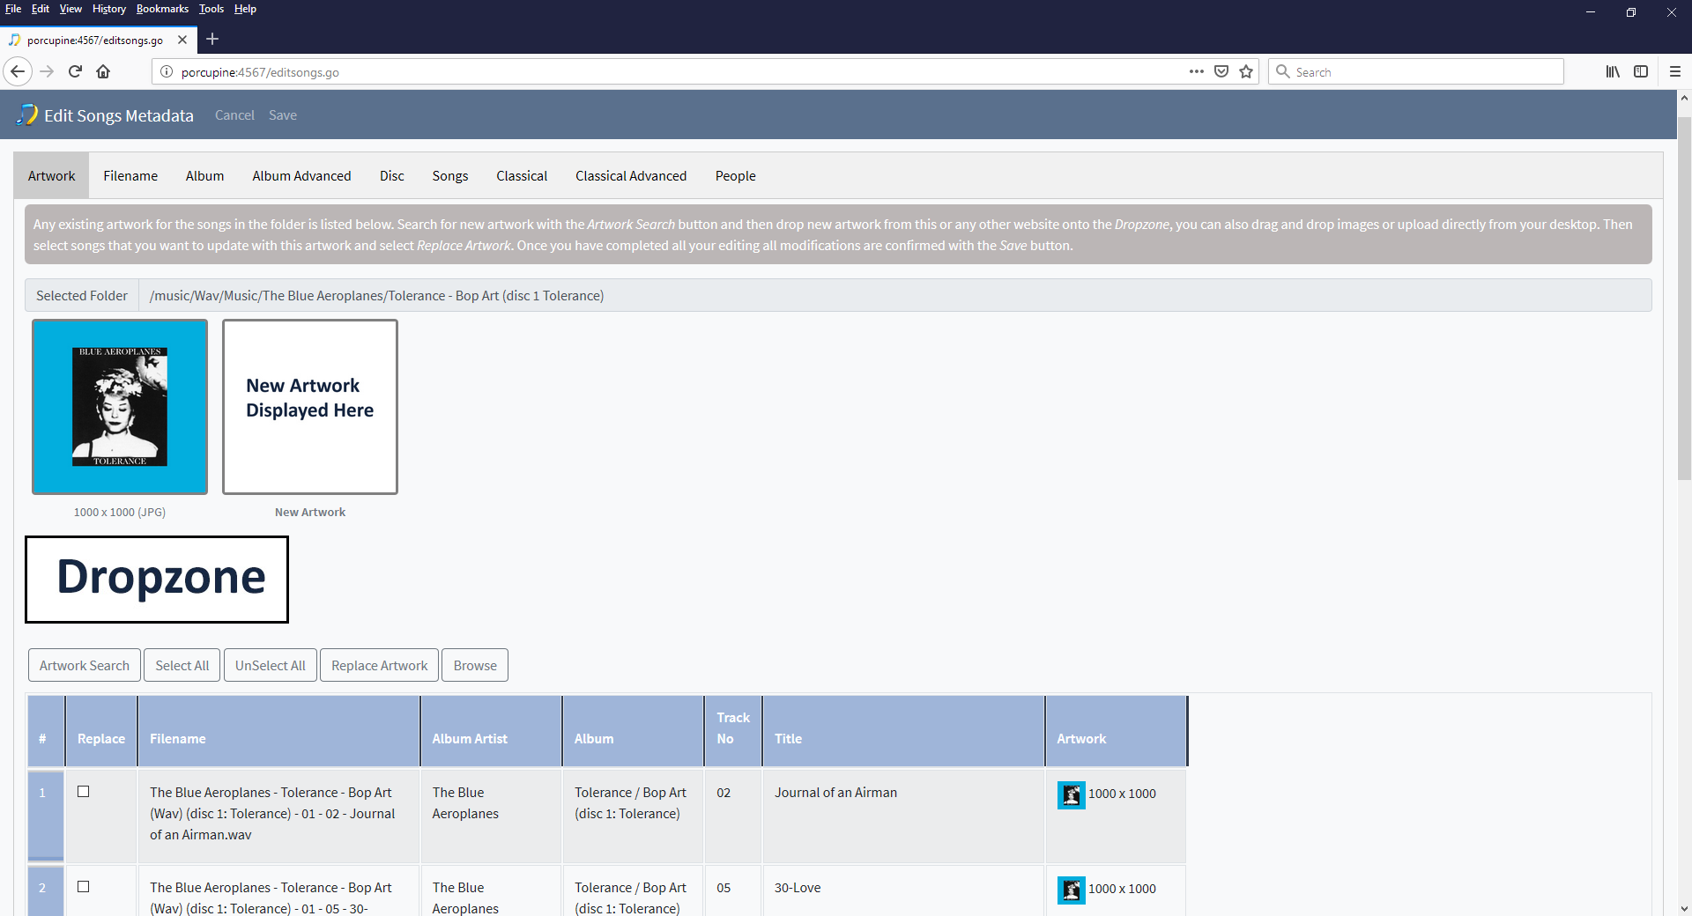
Manual Edit -Artwork

Slide 34
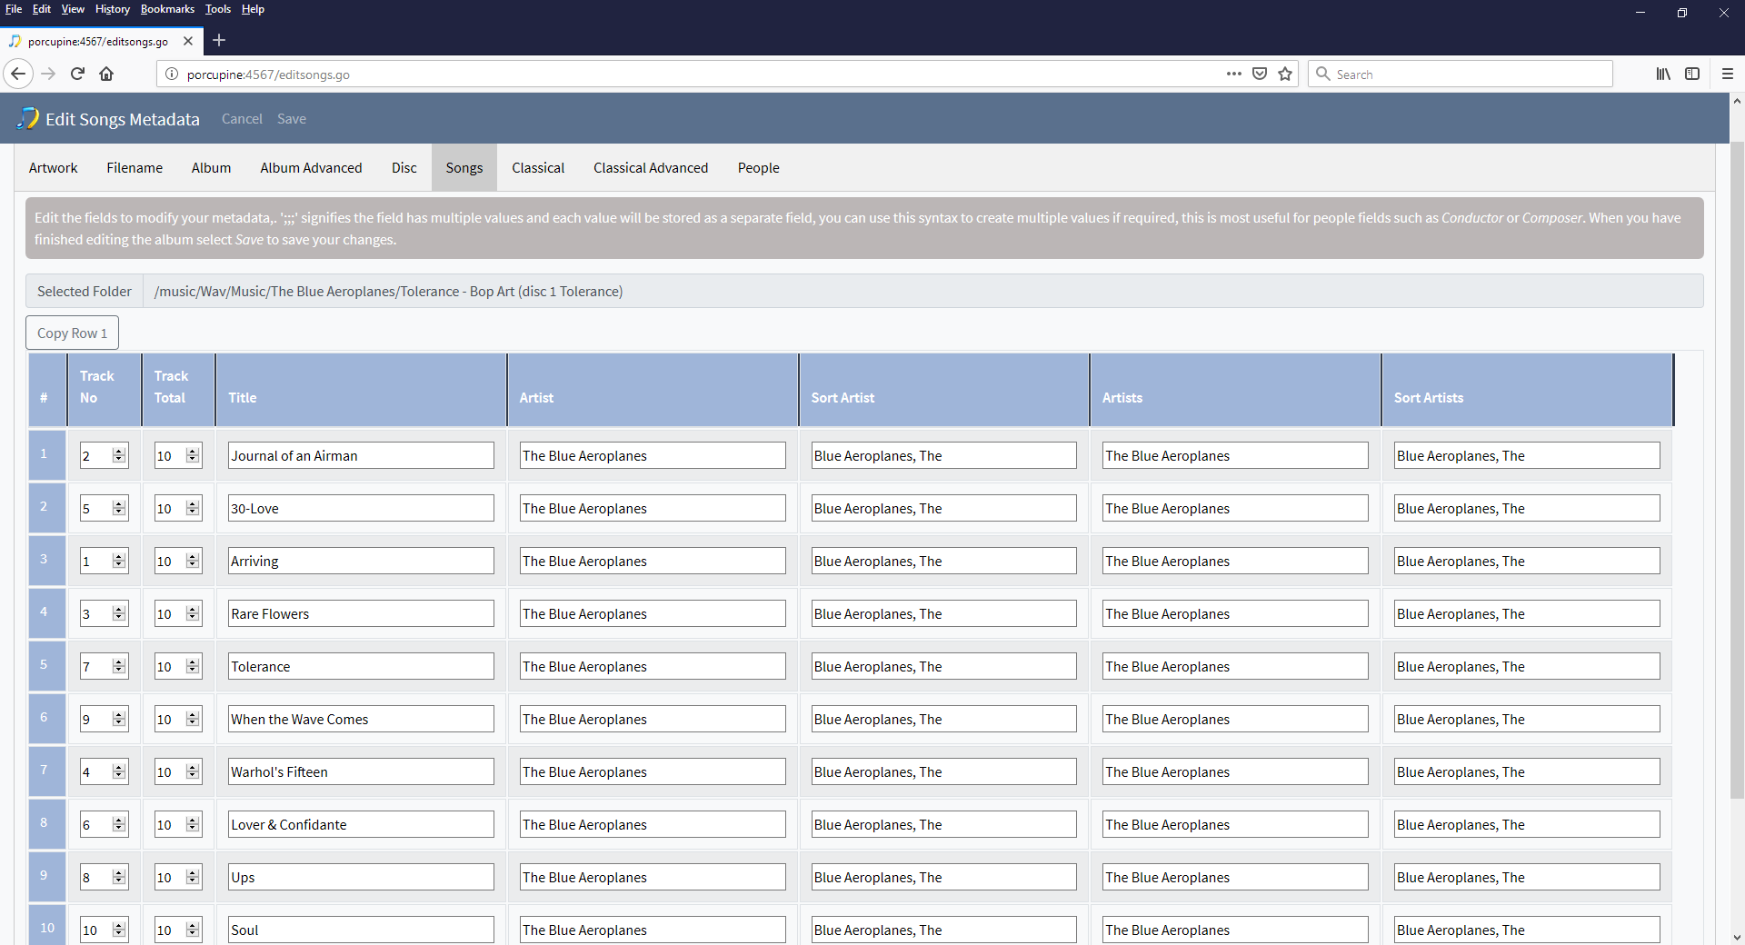
Manual Edit –Album Advanced

Slide 35
SongKong – Review Two
Status Report shows status of existing metadata
Delete Duplicate songs for finding duplicates
Manual Edit via web browser
Can be controlled as Desktop app or via Web Browser so no need to copy files to PC to edit

Slide 36
Future Plans
Add Artists Images
Extend Artwork sources
Interactive Single Album Matcher, with review stage
Scripting to allow Tag expressions e.g. composer = composerSort
Extend Matching to include Album Group when we can identify the album but the exact album version matching customers songs is not in database
Artist Matcher, where we can identify artist but not song so we can ensure consistent Artist and Sort Artist names

Slide 37
Cost
£25 , with 1 year of version updates
£35, Pro version with faster processing and acoustic Analysis
£40, Melco version, with additional Naim file processing
After one year, an additional year of version updates is £10
Free email and forum support

